Slide 1
CSC 362: Systems Programming
Lecture 22
Original slides by: Amitabha Dey
Adapted by: Dr. Richard Johnson
Department of Computer Science
University of North Carolina at Greensboro
Notes:
Mnemonics for OSI Model:
"All People Seem To Need Data Processing"
"Please Do Not Throw Sausage Pizza Away"
"Please Do Not Teach Sales People Anything"
OSI: Open Systems Interconnection

Slide 2

What we will cover in Networking
OSI Model - 7 Layers
TCP/IP Model
Client-Server Model
Socket Programming
UDP, TCP
Host Byte Order to Network Byte Order Conversion
Socket Functions
connect, bind, listen, accept, send, receive, close
Network Security
Malware, DoS Attacks, MitM Attacks, Phishing, etc.
Virtualization & Containers
Dockers

Slide 3
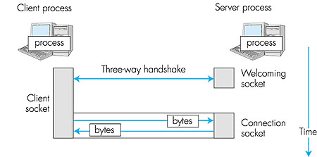
Socket Programming
Goal: Learn how to build client/server applications that communicate using sockets
Socket programming is a way for computers to communicate with each other over a network using sockets, which are software endpoints for sending or receiving data. It enables applications to establish connections, send data, and receive data across a network, such as the internet.
In socket programming, one computer acts as a server, listening for incoming connections, while the other acts as a client, initiating the connection.
Once a connection is established, both the client and server can send and receive data.
Image credit - https://netlab.ulusofona.pt/
Notes:
Fundamentals of Sockets and Client-Server Model
Goal: The primary objective is to learn how to build client/server applications that communicate via sockets.
What is a Socket?:
Sockets are software endpoints used for sending or receiving data over a network.
They allow applications to establish connections and exchange data across networks like the internet.
Relies on client-server model.
---
TCP Connection Concept
A diagram showing the high-level relationship between a client process and a server process using sockets over time.
Long Description:
This diagram illustrates the temporal flow of a connection-oriented communication.
On the left is the Client process with a single Client socket.
On the right, the Server process is shown with two distinct stages: a Welcoming socket and a Connection socket.
An arrow labeled Three-way handshake connects the client socket to the server's welcoming socket.
Once established, the server transitions to a dedicated Connection socket.
The lower half shows horizontal blue arrows labeled bytes moving back and forth between the client and the specific connection socket,
representing data transfer. A vertical arrow on the far right indicates the downward progression of Time.

Slide 4
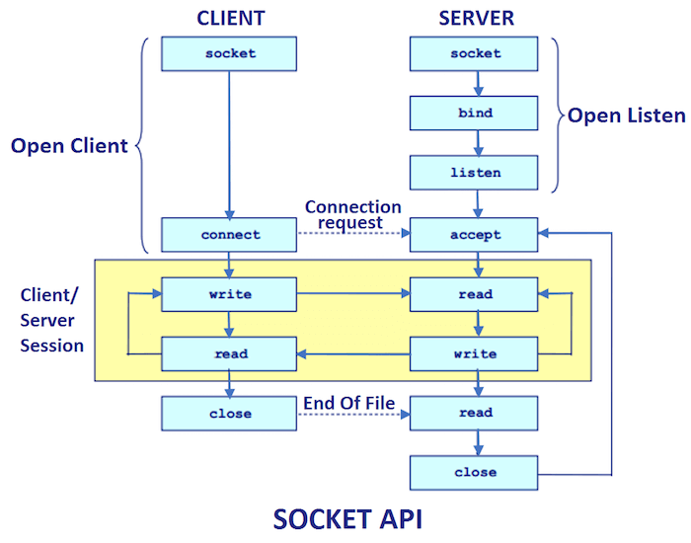
The client-server model
The client-server model is one of the most used communication paradigms in networked systems. Clients normally communicates with one server at a time.
From a server’s perspective, at any point in time, it is not unusual for a server to be communicating with multiple clients.
Client need to know of the existence of and the address of the server, but the server does not need to know the address of (or even the existence of) the client prior to the connection being established
Client and servers communicate by means of multiple layers of network protocols.
Image credit - https://www.javatpoint.com/
Notes:
Fundamentals of Sockets and Client-Server Model
Client-Server Roles:
Server: Acts as a listener for incoming connection requests.
Client: Initiates the connection.
Once connected, both can send and receive data bidirectionally.
Interaction Dynamics:
Clients usually talk to one server at a time, but servers often communicate with multiple clients simultaneously.
Clients must know the server's address, but the server does not need to know the client's identity before the connection is made.
---
Socket API Lifecycle
A flow chart of the Socket API function calls for both Client and Server from initialization to closure.
Long Description: A detailed sequence of system calls for network communication.
Server Side: Starts with socket → bind → listen (bracketed as Open Listen). It then moves to accept, where it blocks until a Connection request is received.
Client Side: Starts with socket (bracketed as Open Client) and moves to connect.
Data Exchange: A yellow box labeled Client/Server Session shows a loop where the client writes and the server reads, and vice versa.
Termination: The client calls close, sending an End Of File signal. The server reads this, calls its own close, and returns to the accept state to wait for the next client.
---
For reference:
The steps involved in establishing a TCP socket on the server side are as follows:
Create a socket with the socket() function;
Bind the socket to an address using the bind() function;
Listen for connections with the listen() function;
Accept a connection with the accept() function system call. This call typically blocks until a client connects with the server.
Send and receive data by means of send() and receive().

Slide 5
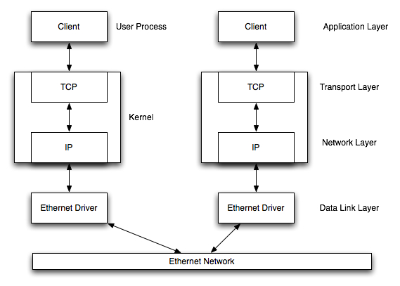
The client-server model
Client and the server on the same local network -
LAN (Local Area Network)
Covers a small geographical area, such as a single building, office, or campus.
Usually owned, controlled, and operated by a single organization, such as a company, school, or government agency
Characteristics: High data transfer rates, low latency, and high security
Image credit - https://www.cs.dartmouth.edu/
Notes:
Fundamentals of Sockets and Client-Server Model
LAN (Local Area Network):
Small geographical area (e.g., one building), high speed, low latency, and high security.
---
Client-Server Model
A diagram illustrating the communication flow between two clients over an Ethernet network,
showing the interaction between the application, transport, network, and data link layers
within the user process and the operating system kernel.
Long Description:
The image depicts a structural model of network communication between two identical client systems connected via an Ethernet Network.
The diagram is organized vertically into layers, representing the path of data from the user level down to the physical hardware.
At the top is the Application Layer containing the User Process (Client).
Below this is the Kernel, which houses the Transport Layer (TCP) and the Network Layer (IP).
Data moves vertically from the User Process through the TCP and IP blocks to the Data Link Layer (Ethernet Driver).
The two hosts are connected at the bottom via an Ethernet Network horizontal bar.
Architectural Boundaries
User Process: The top section contains the Client, situated in the Application Layer.
Kernel: The middle section represents the operating system's kernel, which houses the Transport Layer (TCP) and the Network Layer (IP).
Hardware/Driver Level: The bottom section contains the Ethernet Driver, situated in the Data Link Layer.
Communication Workflow
Vertical Flow: On each side of the diagram, double-headed arrows show bi-directional communication between the Client, TCP, IP, and the Ethernet Driver. This illustrates how data is encapsulated as it moves down the stack and decapsulated as it moves up.
Horizontal Connectivity: At the very bottom, both Ethernet Drivers are connected to a single horizontal block labeled Ethernet Network via double-headed arrows. This represents the physical or logical medium through which the two systems exchange data frames.
Layer Mapping
Application Layer: Where the Client software operates.
Transport Layer: Managed by TCP within the kernel.
Network Layer: Managed by IP within the kernel.
Data Link Layer: Managed by the Ethernet Driver, interfacing directly with the physical Ethernet Network.

Slide 6
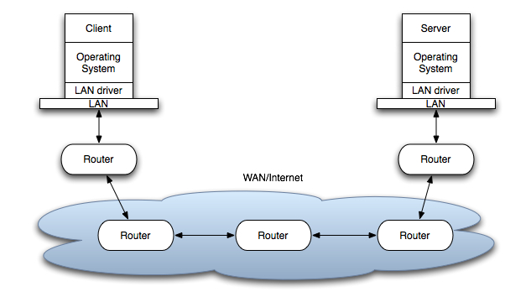
The client-server model
The client and the server may be in different LANs, with both LANs connected to a Wide Area Network (WAN) by means of routers. The largest WAN is the Internet, but companies may have their own WANs.
Spans a large geographical area, often connecting multiple LANs or other networks across cities, countries, or even continents.
Can be owned and operated by multiple organizations, telecommunications companies, or service providers.
Characteristics: Lower data transfer rates, higher latency, and lower security compared to LANs due to the larger distances and the involvement of multiple service providers.
Various technologies for long-distance communication, including leased lines, fiber optics, satellites, and the internet.
Image credit - https://www.cs.dartmouth.edu/
Notes:
Fundamentals of Sockets and Client-Server Model
WAN (Wide Area Network):
Large area (e.g., cities or continents), lower speeds, higher latency, and lower security.
The Internet is the largest example.
---
Wide Area Network Architecture
A high-level view of a Client and Server communicating across a WAN/Internet via multiple routers.
Long Description:
This diagram shows a Client and Server,
each consisting of an Application, Operating System, and LAN driver.
Each is connected to a local LAN which connects to a Router.
These local routers are connected to a cloud-shaped area labeled WAN/Internet,
which contains a series of interconnected Routers that handle the multi-hop path between the two end systems.

Slide 7
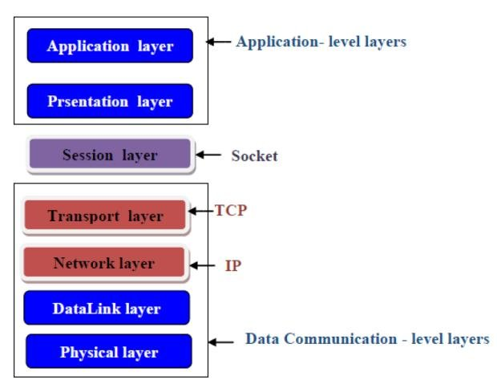
Socket Programming
The socket API sits between the application layer and the transport layer in the networking protocol stack.
It provides an interface for applications to interact with the transport layer protocols, such as TCP (Transmission Control Protocol) or UDP (User Datagram Protocol), without needing to understand the intricacies of these protocols.
Image credit - Al-Naima, Fawzi & Ameen, Hussein. (2016). Design of an RFID-based Students/Employee Attendance System. Majlesi Journal of Electrical Engineering. 10. 23-33.
Notes:
Socket Programming Mechanics
API Placement:
The socket API resides between the Application layer and the Transport layer (TCP/UDP).
It serves as an interface so applications can use transport protocols without knowing their internal complexities.
---
OSI Layer Mapping
A color-coded diagram mapping specific network protocols and interfaces to the OSI model layers.
Long Description: The diagram separates layers into two categories:
Application-level layers: Includes the Application layer and Presentation layer (blue).
Data Communication-level layers: Includes the Transport layer (mapped to TCP), Network layer (mapped to IP), DataLink layer, and Physical layer.
The Session layer (purple) is explicitly labeled as the Socket, acting as the interface between the application-level and data-level layers.

Slide 8
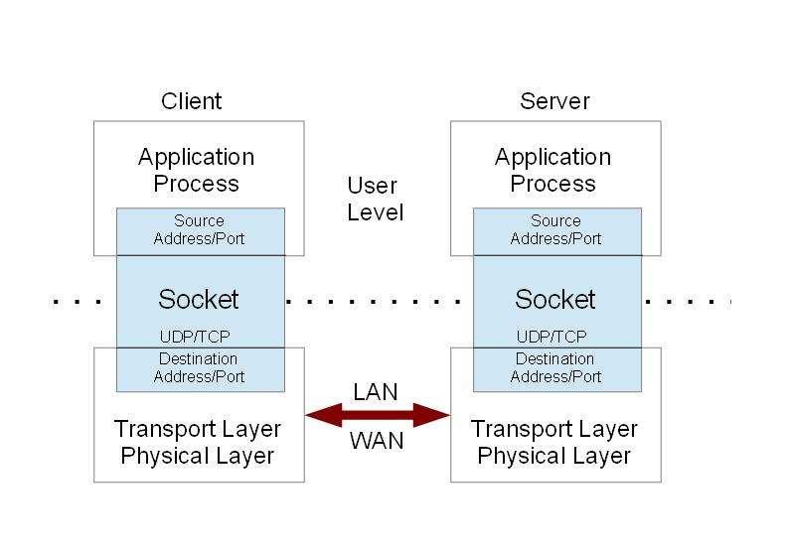
Socket Programming
You must open a socket first before any data can be transferred.
A socket specifies the address and port number of the remote host, the local port number, and the transfer protocol (UDP or TCP).
A socket does not specify the direction of the data transfer; each socket can handle bi-directional transfers.
A connection can either be a server or a client. A server connection listens for incoming data on its source port. If data is received, the server responds. A client however actively connects to a server, sends data and receives the server's response.
Image credit - https://www.dsignt.de/
Notes:
Socket Programming Mechanics
Socket Requirements:
Before data transfer, a socket must be opened.
It defines the remote host address, remote port, local port, and the chosen protocol (UDP or TCP).
---
Socket Abstraction
A conceptual diagram showing the Socket acting as an interface between the Application Process and the Transport Layer.
Long Description:
Two identical blocks represent the Client and Server.
At the top of each is the Application Process.
Below this is the Socket (shaded light blue), which contains sub-sections for
Source Address/Port,
the protocol (UDP/TCP),
and the Destination Address/Port.
A dotted line passes through the sockets of both hosts, representing the logical connection.
Below the socket is the Transport/Physical Layer,
with a double-headed arrow labeled LAN/WAN connecting the two hosts at this lower level.

Slide 9
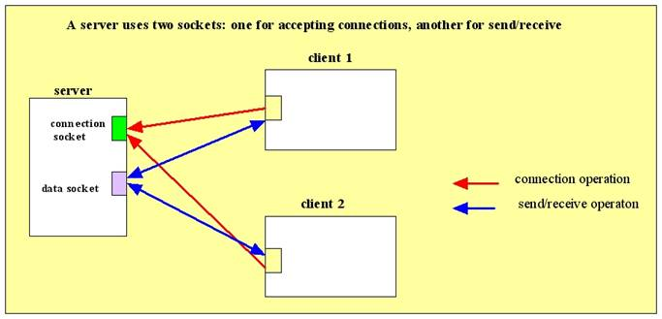
Socket Programming
Connection socket - used by the server to listen for incoming connection requests from clients. → Unidirectional
Data socket - created by the server when it accepts a connection request from a client. → Bidirectional
Image credit - https://csis.pace.edu/
Notes:
Socket Programming Mechanics
Socket Types:
Connection Socket: Used by the server strictly to listen for incoming requests (unidirectional).
Data Socket: Created by the server specifically to communicate with an accepted client (bidirectional).
---
Multi-Client Server Sockets
A diagram showing a server using separate sockets to manage connections and data transfer for multiple clients.
Long Description:
A large box on the left represents the Server.
It contains a green connection socket and a purple data socket.
Two smaller boxes on the right represent Client 1 and Client 2.
Red arrows (labeled connection operation) point from both clients to the server's connection socket.
Blue arrows (labeled send/receive operation) show the actual data exchange between the clients and the server's data socket.

Slide 10
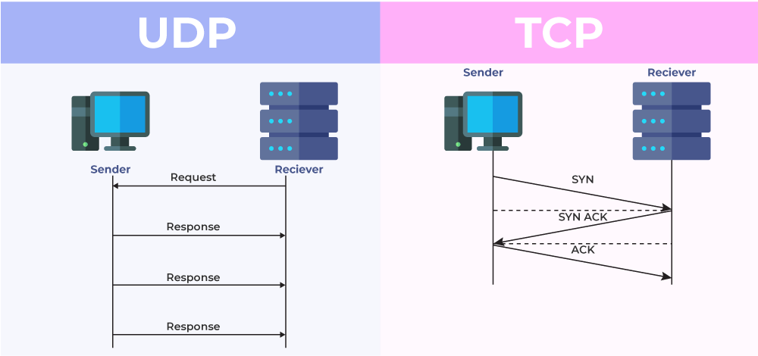
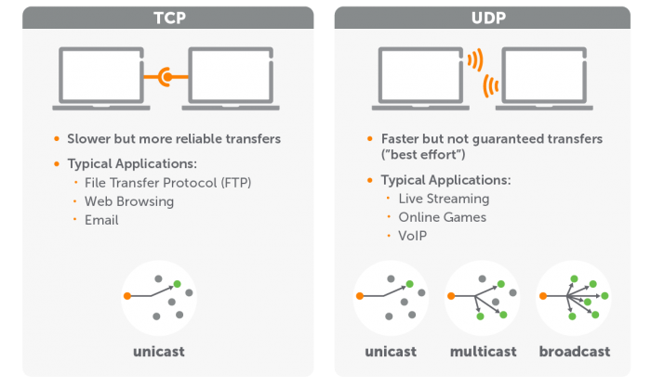
Socket Programming
Two socket types for two transport services:
UDP -
Speed and efficiency are prioritized over reliability;
With UDP sockets, data is sent as discrete packets (datagrams). These datagrams are sent independently and may arrive out of order or be lost.
Applications using UDP sockets must handle issues such as packet loss, duplication, and reordering themselves if necessary.
TCP -
Reliable, connection-oriented communication mechanism;
TCP handles tasks such as data segmentation, acknowledgment, retransmission, and flow control to guarantee reliable data delivery.
Image credit - https://www.geeksforgeeks.org/
Image credit - https://www.wowza.com/
Notes:
Two Transport Protocols: UDP vs. TCP
UDP (User Datagram Protocol):
Prioritizes speed and efficiency over reliability.
Sends "datagrams" as discrete, independent packets that may be lost or arrive out of order.
TCP (Transmission Control Protocol):
Reliable, connection-oriented "byte-stream" transfer (like a pipe).
Summary Comparison
TCP Connection
Handshake: 3-way (SYN, SYN-ACK, ACK)
Kernel State: Maintains sequence numbers/windows
Termination: 4-way (FIN/ACK)
Reliability: Guaranteed delivery/ordering
UDP "Connection"
Handshake: None
Kernel State: None (unless filtered by connect())
Termination: Just stop sending data
Reliability: Best effort (packets can be lost or reordered)
---
Figure 1: UDP vs. TCP Handshake
A side-by-side comparison of communication flows for UDP and TCP protocols.
Long Description:
UDP: Shows a simple, direct exchange. The sender sends a Request, and the receiver sends multiple Response packets. There is no setup phase.
TCP: Shows a connection setup phase using the Three-Way Handshake. The sender sends a SYN, the receiver responds with SYN ACK, and the sender returns an ACK. Only after this sequence do the data arrows begin.
Figure 2: Protocol Characteristics and Use Cases
An infographic comparing the reliability, speed, and typical applications of TCP versus UDP.
Long Description:
TCP: Described as "Slower but more reliable transfers." Applications listed: FTP, Web Browsing, Email. It is visually associated with unicast (one-to-one).
UDP: Described as "Faster but not guaranteed transfers ('best effort')." Applications listed: Live Streaming, Online Games, VoIP. It is visually associated with unicast, multicast, and broadcast communication modes. communication.

Slide 11
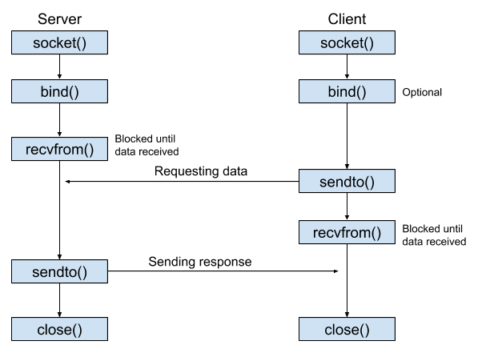
Socket Programming with UDP
UDP - no “connection” between client and server
No handshake before sending data
Sender explicitly attaches IP destination address and port # to each packet
Receiver extracts sender IP address and port # from received packet
Transmitted data may be lost or received out of order
Application viewpoint -
UDP provides unreliable transfer of groups of bytes (“datagrams”) between client and server processes
Applications using UDP sockets must handle issues such as packet loss, duplication, and reordering themselves if necessary.
Notes:
UDP (User Datagram Protocol):
UDP is message-oriented. Sends "datagrams" as discrete, independent packets of data that may be lost or arrive out of order.
Connectionless: No handshake occurs; the sender must attach the destination IP and port to every packet.
The Standard Workflow (Sendto/Recvfrom)
In the most common UDP implementation, the kernel acts as a simple pass-through.
Socket Creation: You create a socket using SOCK_DGRAM.
Binding (Receiver): The receiver calls bind() to tell the OS, "Any UDP packets arriving on Port X should be given to me.“
Data Transfer: The sender uses sendto(), specifying the destination IP and Port every single time. The receiver uses recvfrom(), which provides the sender's address along with the data so the receiver knows where it came from.
User Mode vs. Kernel Mode for UDP
Because there is no handshake, the overhead is much lower than TCP:
User Mode: The application simply drops a "datagram" (a block of data) into the socket.
Kernel Mode: The kernel wraps the data in a UDP header (which is only 8 bytes) and an IP header, then pushes it directly to the NIC driver. There is no buffering for retransmission or flow control logic.
UDP “Connection”
Handshake: None
Kernel State: None (unless filtered by connect())
Termination: Just stop sending data
Reliability: Best effort (packets can be lost or reordered)
---
UDP Socket Lifecycle
A flow chart showing the sequence of system calls for a connectionless UDP communication between a Server and a Client.
Long Description:
This diagram illustrates the interaction between a Server and a Client using the User Datagram Protocol.
Server Side: It initializes with socket(), then bind() to a port. It enters a recvfrom() state, which is labeled "Blocked until data received.“
Client Side: It starts with socket(). The bind() call is labeled as "Optional." It then executes sendto() to request data.
Exchange: Once the server receives the request, it processes it and calls sendto() to send a response back to the client. The client, meanwhile, has moved to a recvfrom() state (also blocked until data is received).
Termination: Both processes finish by calling close().
---
For reference:
The "Protocol" Buffer vs. The "Network“
When you call sendto(), the operating system takes the data from your application-level buffer and copies it into the kernel's outgoing network buffer.
Completion: As soon as that copy is finished, sendto() returns.
The UDP Reality: It does not wait for the data to actually reach the destination, nor does it wait for an acknowledgment (since UDP doesn't use them). Because memory-to-memory copying is incredibly fast, sendto() usually returns almost instantaneously.
When does it actually block?
sendto() will only block if the kernel's send buffer is completely full.
This happens if:
You are generating data significantly faster than your local network interface card (NIC) can push bits onto the wire.
The local outgoing queue is congested.
If the buffer is full, the thread will sleep until there is enough room to copy your new packet into the kernel.

Slide 12
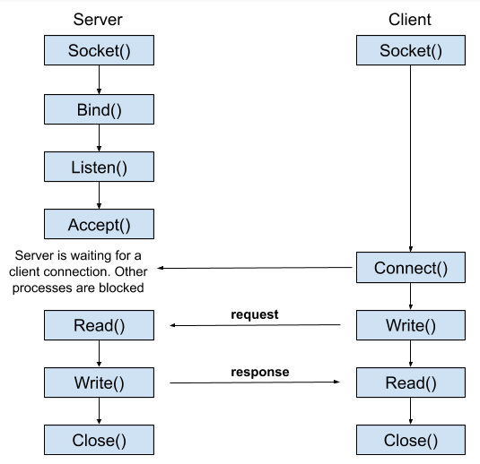
Socket Programming with TCP
Client must contact server
Server process must first be running
Server must have created socket (door) that welcomes client’s contact
Client contacts server by:
Creating TCP socket, specifying IP address, port number of server process
When client creates socket: Client TCP establishes connection to server TCP
When contacted by client:
Server TCP creates new socket for server process to communicate with that particular client
Allows server to talk with multiple clients
Source port numbers used to distinguish clients
TCP: reliable, in-order byte-stream transfer (“pipe”) connection-oriented communication mechanism
Notes:
TCP is byte-stream oriented. This means it treats data as a continuous,
flowing sequence of bytes with no inherent beginning or end markers provided by the protocol itself.
(i.e., uses “streams” instead of “datagrams”)
TCP Connection
Handshake: 3-way (SYN, SYN-ACK, ACK)
Kernel State: Maintains sequence numbers/windows
Termination: 4-way (FIN/ACK)
Reliability: Guaranteed delivery/ordering
---
TCP Socket Lifecycle
A flow chart showing the synchronous system calls for a connection-oriented TCP communication between a Server and a Client.
Long Description:
This diagram shows the complex handshake and data flow of TCP.
Server Setup: socket() → Bind() → Listen() → Accept(). At Accept(), a note states the "Server is waiting for a client connection. Other processes are blocked.“
Client Connection: The client calls socket(), then Connect(), which triggers the server's acceptance.
Data Loop: The client initiates a Write() (request), which the server receives via Read(). The server then Write()s a response, which the client Read()s.
Termination: Both sides conclude with Close().
---
For reference:
The steps involved in establishing a TCP socket on the server side are as follows:
Create a socket with the socket() function;
Bind the socket to an address using the bind() function;
Listen for connections with the listen() function;
Accept a connection with the accept() function system call. This call typically blocks until a client connects with the server.
Send and receive data by means of send() and receive().

Slide 13

Transmission Control Protocol (TCP)
TCP provides a connection-oriented service, since it is based on connections between clients and servers.
TCP provides reliability. When a TCP client send data to the server, it requires an acknowledgement in return. If an acknowledgement is not received, TCP automatically retransmit the data and waits for a longer period of time.
TCP is instead a byte-stream protocol, without any boundaries at all.
TCP is described in RFC 793, RFC 1323, RFC 2581 and RFC 3390.
The Internet Engineering Task Force (IETF) is a standards organization for the Internet and is responsible for the technical standards that make up the Internet protocol suite.
https://datatracker.ietf.org/doc/html/rfc793
Notes:
TCP (Transmission Control Protocol):
Reliable, connection-oriented "byte-stream" transfer (like a pipe).
Uses acknowledgments; if a client does not receive one, it retransmits the data, and waits for a longer period of time (Exponential Backoff).
Requires a "welcoming socket" on a running server for the client to contact.

Slide 14
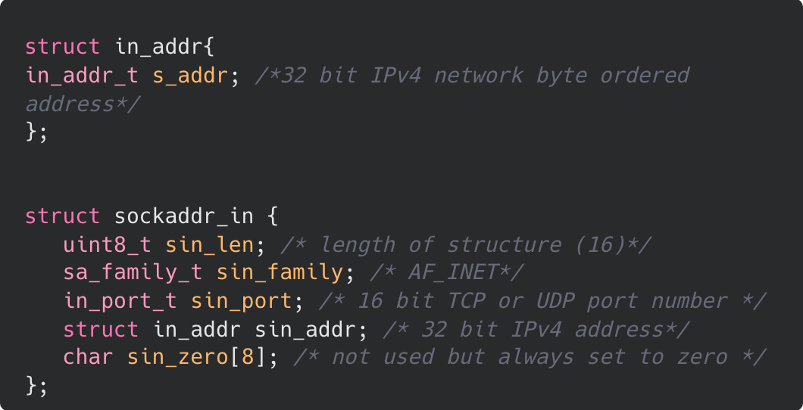
Transmission Control Protocol (TCP)
Socket addresses
IPv4 socket address structure is named sockaddr_in and is defined by including the <netinet/in.h> header.
The POSIX definition is the following:
This structure represents an IPv4 address.
It contains a single member s_addr of type in_addr_t.
s_addr stores the 32-bit IPv4 address in network byte order.
Notes:
---
in_addr C Structure
Code snippet highlighting the C structure used to store a 32-bit IPv4 address.
Long Description:
The image shows a dark-themed code block with a red box highlighting the struct in_addr.
It contains a single member: in_addr_t s_addr;.
A comment explains this is a "32 bit IPv4 network byte ordered address."
Below it, the sockaddr_in structure is visible but not highlighted.

Slide 15
Transmission Control Protocol (TCP)
Socket addresses
sin_len: The length of the structure, typically set to 16.
sin_family: Specifies the address family, which for IPv4 is usually AF_INET.
sin_port: The port number associated with the socket. It's a 16-bit value representing the TCP or UDP port number. Ports are used to differentiate between different services on the same host.
sin_addr: An instance of struct in_addr, representing the IPv4 address of the host or server. It contains the 32-bit IPv4 address in network byte order.
sin_zero: A field of 8 bytes, traditionally not used but filled with zeros. It exists to ensure that struct sockaddr_in has the same size as struct sockaddr, which is required for compatibility reasons.
IPv4 socket address structure is named sockaddr_in and is defined by including the <netinet/in.h> header.
The POSIX definition is the following:
Notes:
Socket Address Structure (IPv4):
Defined in <netinet/in.h> as sockaddr_in.
sin_family: Address family (AF_INET for IPv4).
sin_port: 16-bit port number to differentiate services on a host.
sin_addr: 32-bit IPv4 address stored in network byte order.
---
sockaddr_in C Structure
Code snippet highlighting the sockaddr_in C structure used for IPv4 socket addressing.
Long Description:
This image highlights the larger struct sockaddr_in in a red box.
It includes:
uint8_t sin_len; (length of structure)
sa_family_t sin_family; (set to AF_INET)
in_port_t sin_port; (16-bit TCP/UDP port number)
struct in_addr sin_addr; (The 32-bit IPv4 address structure)
char sin_zero[8]; (Padding used to align the structure, set to zero).
---
For reference:
AF_INET is a constant representing the address family for IPv4 Internet protocols in network socket programming.
It is used in the socket creation process to specify that communication will occur over IP addresses and ports,
typically paired with SOCK_STREAM (TCP) or SOCK_DGRAM (UDP).
It operates on 32-bit IPv4 addresses.
sin: socket internet

Slide 16
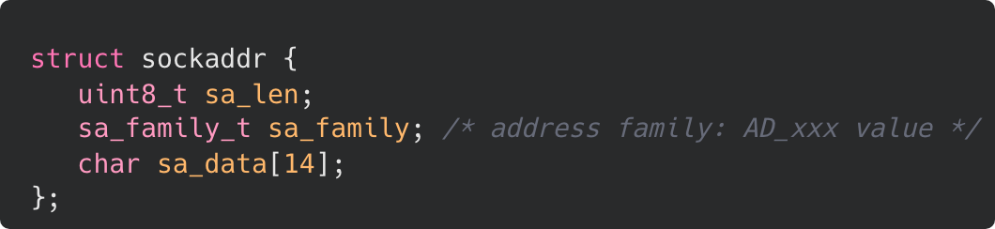
Transmission Control Protocol (TCP)
Generic Socket Address Structure
struct sockaddr provides a flexible and generic way to represent socket addresses, allowing applications to work with different types of addresses without needing to know the specific details of each address family.
When working with specific address families, such as IPv4 or IPv6, developers often use specialized structures like struct sockaddr_in or struct sockaddr_in6, which are based on struct sockaddr but provide additional fields and functionality tailored to the respective address family.
Notes:
---
Generic sockaddr Structure
Code snippet for the generic sockaddr C structure used as a template for various address families.
Long Description:
A simple code block showing struct sockaddr.
It consists of uint8_t sa_len, sa_family_t sa_family (labeled as "address family: AD_xxx value"),
and a character array char sa_data[14] which holds the actual address data.

Slide 17
Transmission Control Protocol (TCP)
Host Byte Order to Network Byte Order Conversion
Goal: To ensure that data is transmitted and interpreted correctly across different systems with varying CPU architectures.

Slide 18
Transmission Control Protocol (TCP)
Host Byte Order to Network Byte Order Conversion
Definition: Byte order, also known as endianness, refers to the order in which bytes are stored in memory or transmitted over a network.

Slide 19
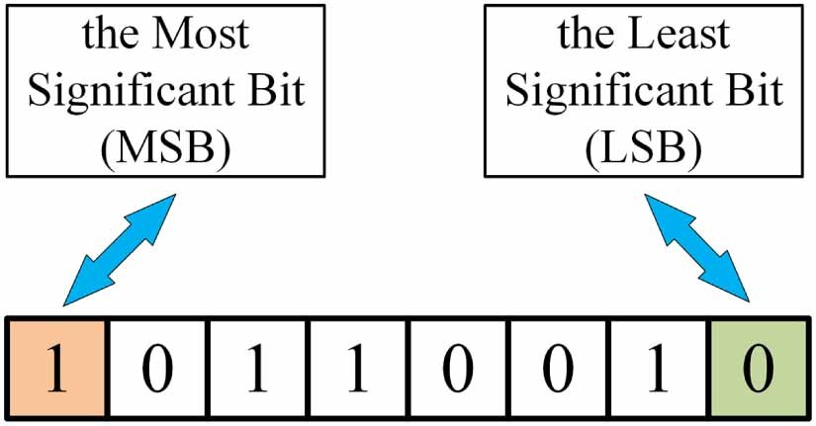
Transmission Control Protocol (TCP)
Host Byte Order to Network Byte Order Conversion
MSB - leftmost bit when representing the number in binary form
LSB - rightmost bit when representing the number in binary form
Image credit - Dong, Yumin & Mou, Dingkang & Liu, Hengrui & Zhu, Tingting. (2023). Quantum color image watermarking scheme based on quantum error correction coding. New Journal of Physics. 25. 10.1088/1367-2630/ad08ca.
Notes:
---
Bit Significance in TCP
Most and Least Significant Bits
Diagram identifying the Most Significant Bit (MSB) and Least Significant Bit (LSB) in a byte.
Long Description:
A horizontal array of 8 cells representing a single byte containing the binary value 10110010.
The leftmost cell is highlighted in orange and contains a 1;
a blue arrow points to it from a box labeled "the Most Significant Bit (MSB)".
The rightmost cell is highlighted in green and contains a 0;
a blue arrow points to it from a box labeled "the Least Significant Bit (LSB)".

Slide 20
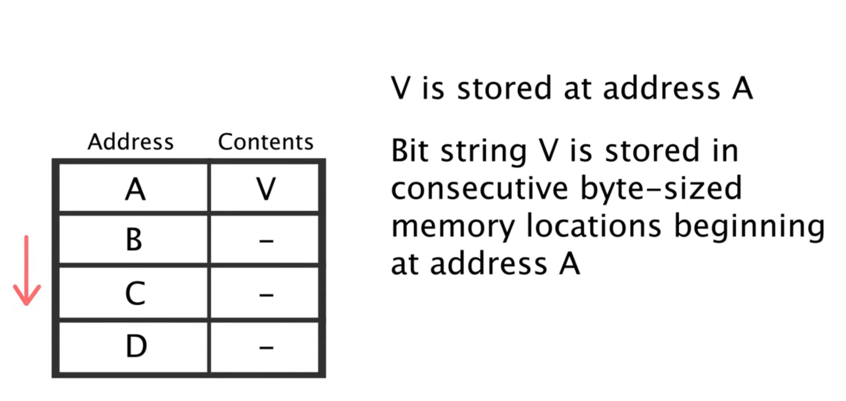
Transmission Control Protocol (TCP)
Host Byte Order to Network Byte Order Conversion
A computer memory is a large array of bytes (8 bits)
Notes:
Computer Memory:
Physical memory is logically organized as a contiguous, byte-addressable sequence,
where each 8-bit unit is assigned a unique numerical address.
---
Computer Memory Byte Array
Diagram representing computer memory as a consecutive array of byte-sized locations.
Long Description:
This image defines memory structure featuring a two-column table with "Address" and "Contents“.
Addresses are labeled A, B, C, and D in descending order, indicated by a red arrow.
Address A contains the value "V“.
To the right, text explains that "V is stored at address A" and that
"Bit string V is stored in consecutive byte-sized memory locations beginning at address A.“

Slide 21
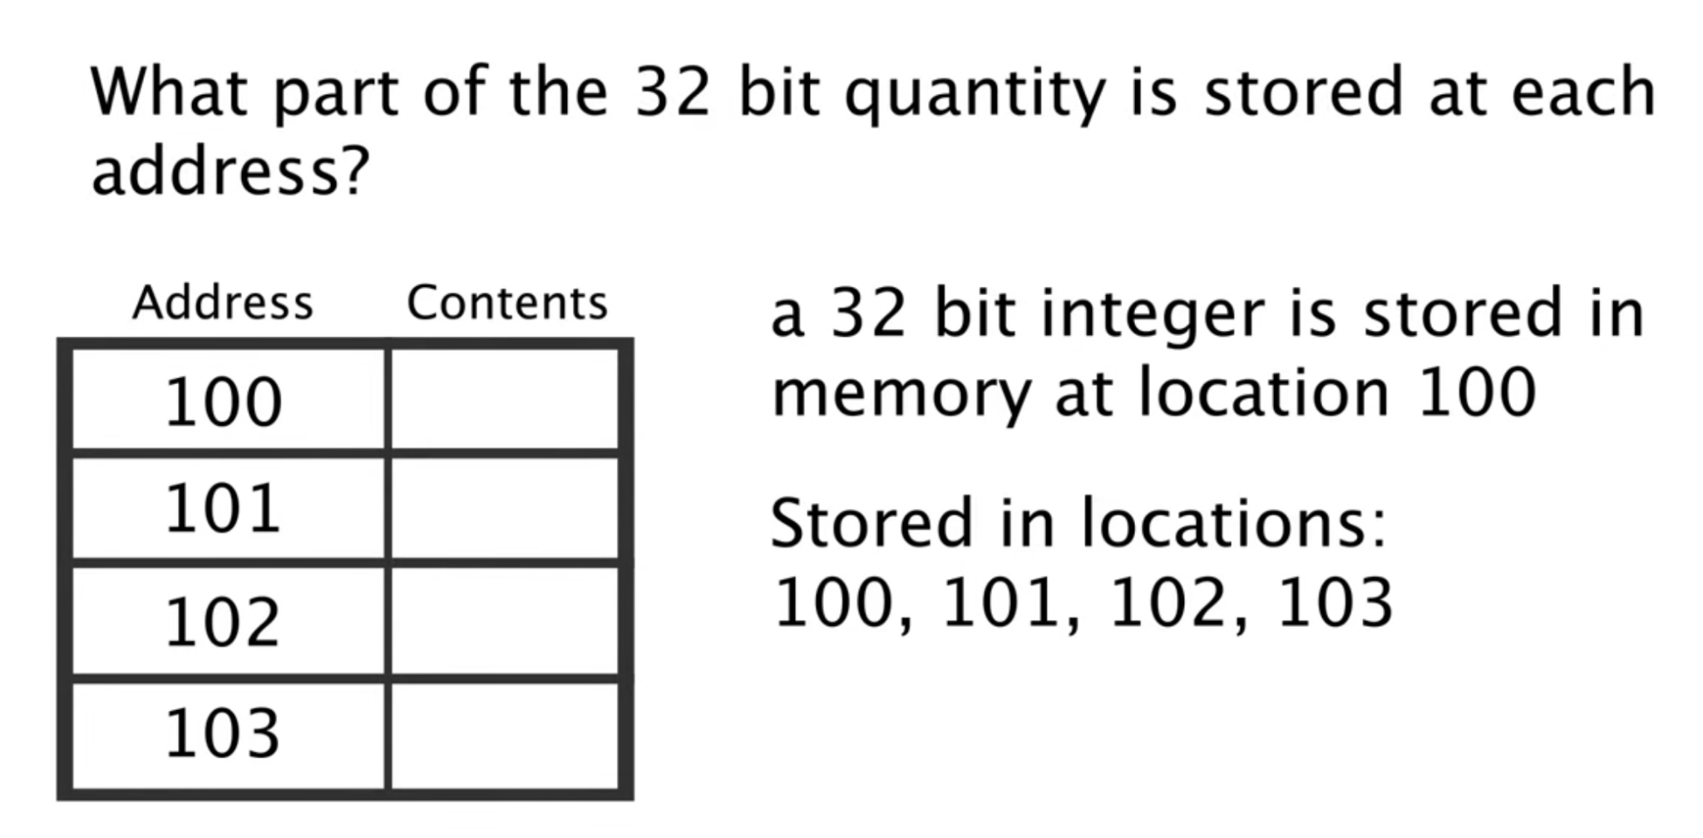
Transmission Control Protocol (TCP)
Host Byte Order to Network Byte Order Conversion
A computer memory is a large array of bytes (8 bits)
Notes:
Q. What part of the 32-bit quantity is stored at each byte address? A. It depends on endianness.
---
32-bit Quantity Storage Challenge
A blank memory table asking how a 32-bit quantity is distributed across four memory addresses.
Long Description:
A slide with a question: "What part of the 32-bit quantity is stored at each address?"
It shows a table with memory addresses 100, 101, 102, and 103, with the "Contents" column left blank.
The text states: "a 32-bit integer is stored in memory at location 100" and specifies that it is "Stored in locations: 100, 101, 102, 103.“

Slide 22
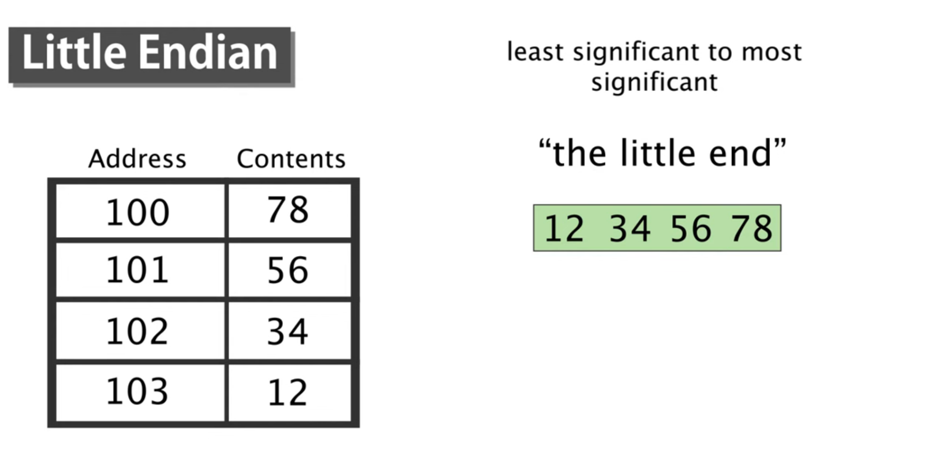
Transmission Control Protocol (TCP)
Host Byte Order to Network Byte Order Conversion
Notes:
---
Little Endian Visualized
Memory table showing Little Endian storage of the hex value 12 34 56 78.
Long Description:
Titled "Little Endian," this image explains "the little end" storage where the least significant byte is stored at the lowest address.
A 32-bit hex value 12 34 56 78 is shown.
In the corresponding memory table:
address
100 contains 78,
101 contains 56,
102 contains 34, and
103 contains 12.

Slide 23
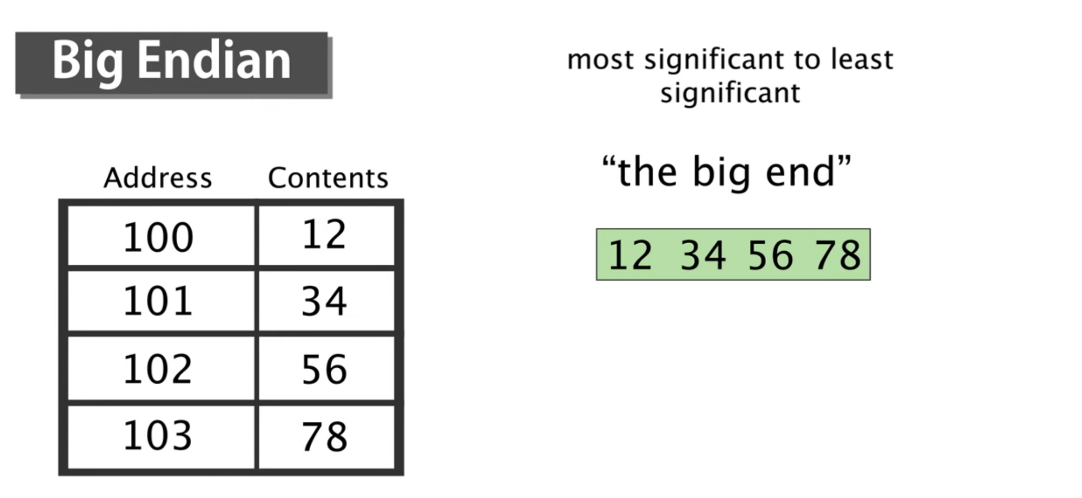
Transmission Control Protocol (TCP)
Host Byte Order to Network Byte Order Conversion
Notes:
---
Big Endian Visualized
Memory table showing Big Endian storage of the hex value 12 34 56 78.
Long Description:
Titled "Big Endian," this image explains "the big end" storage where the most significant byte is stored at the lowest address.
For the same 32-bit hex value 12 34 56 78.
The memory table shows:
address
100 contains 12,
101 contains 34,
102 contains 56, and
103 contains 78.

Slide 24
Transmission Control Protocol (TCP)
Host Byte Order to Network Byte Order Conversion
Two main byte order conventions:
Big-Endian:
In big-endian byte order, the most significant byte (MSB) is stored at the lowest memory address.
Subsequent bytes are stored in increasing order of significance, with the least significant byte (LSB) at the highest memory address.
This byte order is used by network protocols like TCP/IP and UDP/IP for transmitting data over the network.
Little-Endian:
In little-endian byte order, the least significant byte (LSB) is stored at the lowest memory address.
Subsequent bytes are stored in increasing order of significance, with the most significant byte (MSB) at the highest memory address.
This byte order is commonly used by x86-based processors and some other architectures.
Notes:
Byte Order (Endianness):
Big-Endian (Network Byte Order): Most significant byte (MSB) is stored at the lowest address. Used for transmitting data over networks.
Little-Endian (Host Byte Order): Least significant byte (LSB) is at the lowest address. Common in x86-based CPUs for efficient processing.

Slide 25
Transmission Control Protocol (TCP)
Host Byte Order to Network Byte Order Conversion
Network Byte Order:
Network byte order is a standardized byte order used for transmitting data over the network.
It is defined as big-endian, meaning the most significant byte (MSB) is transmitted first, followed by the least significant byte (LSB).
All network protocols, such as TCP/IP and UDP/IP, specify that multi-byte data types should be transmitted in network byte order to ensure interoperability between different systems.
Network byte order allows data to be transmitted and interpreted consistently across systems with varying CPU architectures.
Host Byte Order:
Host byte order is determined by the CPU architecture of the host machine.
For example, x86-based processors commonly use little-endian byte order, where the least significant byte (LSB) is stored at the lowest memory address.
Other architectures, such as PowerPC and SPARC, may use big-endian byte order or even bi-endian formats.
Host byte order is used for representing data within the host's memory.
Notes:
Byte Order (Endianness):
Big-Endian (Network Byte Order): Most significant byte (MSB) is stored at the lowest address. Used for transmitting data over networks.
Little-Endian (Host Byte Order): Least significant byte (LSB) is at the lowest address. Common in x86-based CPUs for efficient processing.

Slide 26
Transmission Control Protocol (TCP)
Host Byte Order to Network Byte Order Conversion
host byte order (little endian) is optimized for CPU operations Little-endian byte order is efficient for CPU operations like addition and subtraction, as it aligns with how CPUs process data.
network byte order (big endian) is standardized for transmitting data over networks to ensure interoperability
Big-endian byte order provides a consistent byte ordering for transmitting multi-byte data types over the network, regardless of the host's byte order.
Notes:
Byte Order (Endianness):
Big-Endian (Network Byte Order): Most significant byte (MSB) is stored at the lowest address. Used for transmitting data over networks.
Little-Endian (Host Byte Order): Least significant byte (LSB) is at the lowest address. Common in x86-based CPUs for efficient processing.
---
For Reference:
Architectural Breakdown
The choice of endianness is a fundamental design decision of the Instruction Set Architecture (ISA).
Little-Endian Architectures
This is currently the most dominant order in consumer and enterprise computing.
x86 and x86-64: All Intel and AMD processors use little-endian.
RISC-V: By default, RISC-V is little-endian, though the specification allows for big-endian versions.
iOS/Android Mobile Devices: While the underlying ARM chips are technically capable of both, almost all mobile operating systems run exclusively in little-endian mode.
2. Big-Endian Architectures
Big-endian was the standard for many years in high-end workstations and networking hardware.
IBM z/Architecture (Mainframes): Consistently big-endian.
Motorola 68000 & early SPARC: Classic workstation architectures.
PowerPC (Legacy): Older Mac hardware (G3, G4, G5) was big-endian.
Network Protocols: Often called "Network Byte Order." Regardless of the CPU architecture, protocols like TCP/IP require data to be transmitted in big-endian format.
3. Bi-Endian Architectures
Many modern architectures are "switchable," meaning the processor can be configured to operate in either mode at boot or via a state bit.
ARM (v7, v8, v9): Supports both, but as noted, little-endian is the industry standard for OS implementations.
POWER/PowerPC: Modern Power processors (like those in IBM’s POWER9 servers) can switch, though most modern Linux distributions on Power run in "Little-Endian" mode (PPC64LE).
MIPS: Historically used in both configurations (e.g., the Nintendo 64 was big-endian, while some DECstations were little-endian).

Slide 27
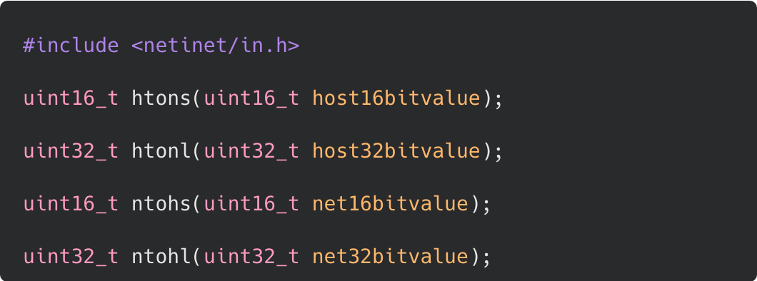
Transmission Control Protocol (TCP)
Host Byte Order to Network Byte Order Conversion
These functions, htons, htonl, ntohs, and ntohl, are used for converting between host byte order and network byte order. They are typically found in the <netinet/in.h> header file, which is part of the standard networking libraries in Unix-like operating systems.
htons (Host to Network Short):
This function converts a 16-bit unsigned integer from host byte order to network byte order.
It takes a 16-bit value in host byte order as input and returns the equivalent value in network byte order.
The "s" in htons stands for "short", indicating that it operates on 16-bit values.
Notes:
Conversion Functions:
Necessary for interoperability between different CPU architectures.
htons / htonl: Host to Network (Short/Long).
ntohs / ntohl: Network to Host (Short/Long).
---
htons Function Prototype
C code snippet highlighting the htons function for 16-bit host-to-network conversion.
Long Description:
A dark-themed code block including <netinet/in.h>.
A red box highlights the line: uint16_t htons(uint16_t host16bitvalue);.
This function converts a 16-bit integer from host byte order to network byte order (Big Endian).

Slide 28
Transmission Control Protocol (TCP)
Host Byte Order to Network Byte Order Conversion
These functions, htons, htonl, ntohs, and ntohl, are used for converting between host byte order and network byte order. They are typically found in the <netinet/in.h> header file, which is part of the standard networking libraries in Unix-like operating systems.
htonl (Host to Network Long):
This function converts a 32-bit unsigned integer from host byte order to network byte order.
It takes a 32-bit value in host byte order as input and returns the equivalent value in network byte order.
The "l" in htonl stands for "long", indicating that it operates on 32-bit values.
Notes:
Conversion Functions:
Necessary for interoperability between different CPU architectures.
htons / htonl: Host to Network (Short/Long).
ntohs / ntohl: Network to Host (Short/Long).
---
htonl Function Prototype
C code snippet highlighting the htonl function for 32-bit host-to-network conversion.
Long Description:
The same code block as the previous image,
but the red box highlights the second line:
uint32_t htonl(uint32_t host32bitvalue);.
This function converts a 32-bit integer from host byte order to network byte order.

Slide 29
Transmission Control Protocol (TCP)
Host Byte Order to Network Byte Order Conversion
These functions, htons, htonl, ntohs, and ntohl, are used for converting between host byte order and network byte order. They are typically found in the <netinet/in.h> header file, which is part of the standard networking libraries in Unix-like operating systems.
ntohs (Network to Host Short):
This function converts a 16-bit unsigned integer from network byte order to host byte order.
It takes a 16-bit value in network byte order as input and returns the equivalent value in host byte order.
Similar to htons, the "s" in ntohs indicates that it operates on 16-bit values.
Notes:
Conversion Functions:
Necessary for interoperability between different CPU architectures.
htons / htonl: Host to Network (Short/Long).
ntohs / ntohl: Network to Host (Short/Long).
---
ntohs Function Prototype
C code snippet highlighting the ntohs function for 16-bit network-to-host conversion.
Long Description:
The code block highlighting the third line:
uint16_t ntohs(uint16_t net16bitvalue);.
This function converts a 16-bit integer from network byte order back to host byte order.

Slide 30
Transmission Control Protocol (TCP)
Host Byte Order to Network Byte Order Conversion
These functions, htons, htonl, ntohs, and ntohl, are used for converting between host byte order and network byte order. They are typically found in the <netinet/in.h> header file, which is part of the standard networking libraries in Unix-like operating systems.
ntohl (Network to Host Long):
This function converts a 32-bit unsigned integer from network byte order to host byte order.
It takes a 32-bit value in network byte order as input and returns the equivalent value in host byte order.
Similar to htonl, the "l" in ntohl indicates that it operates on 32-bit values.
Notes:
Conversion Functions:
Necessary for interoperability between different CPU architectures.
htons / htonl: Host to Network (Short/Long).
ntohs / ntohl: Network to Host (Short/Long).
----
ntohl Function Prototype
C code snippet highlighting the ntohl function for 32-bit network-to-host conversion.
Long Description:
The code block highlighting the final line:
uint32_t ntohl(uint32_t net32bitvalue);.
This function converts a 32-bit integer from network byte order back to host byte order.

